Slide 1
PupilRadio
Building IT Systems
Notes:
Welcome everyone to the pupilradio presentation

Slide 2
The Team
Daniel Popovic
Joshua Bushano
Rudhrakumar Gurunathan
Notes:
I like to introduce out team members
Daniel, Joshua and myself Rudhra
Daniel and Joshua involved in design and development of the website.
Daniel also taken care of streaming functionality later during the build process.
I involved in managing project, some development works and hosting setup.
We all had some knowledge in html and css with our previous learning so we decided to go with a website
Initially we were a group of five members.
One of our member dropped off from this course in week five.
Other one walked away in week 11.
As we lost the resources, it costs us in the development process

Slide 3

PupilRadio
Online music streaming website
Song request
External music resource
Notes:
What is Pupilradio?
It is basically a website playing music online like a radio station
Music streaming is controlled by the play list set up in the server.
Website user has no access to control the songs played like switching to the next or previous song
But we planned to include a song request option with the website.
Where user is provided with a list of options and to choose one of the song from the list and submit the request.
That selected song is then added to the playlist in the server and played later on.
This website also provides an external link to listen music.

Slide 4
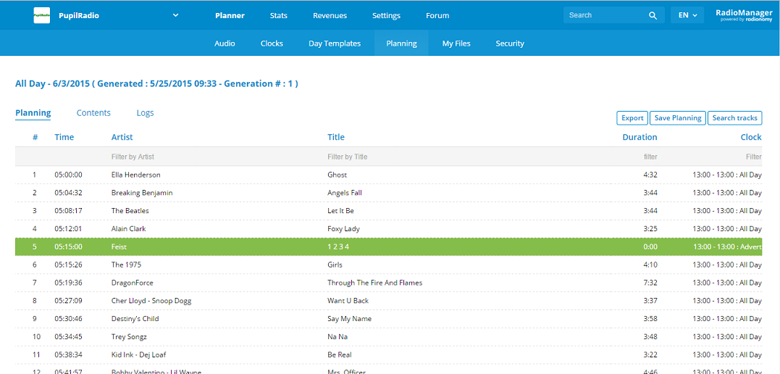
External Resource
Notes:
External resource is streamed from radionomy.com
Radionomy is a free global service that allows users to create their own online radio or listen to online radio all created and programmed by users
where a huge number of songs are available.
We created a radio station and stream our own radio from here

Slide 5
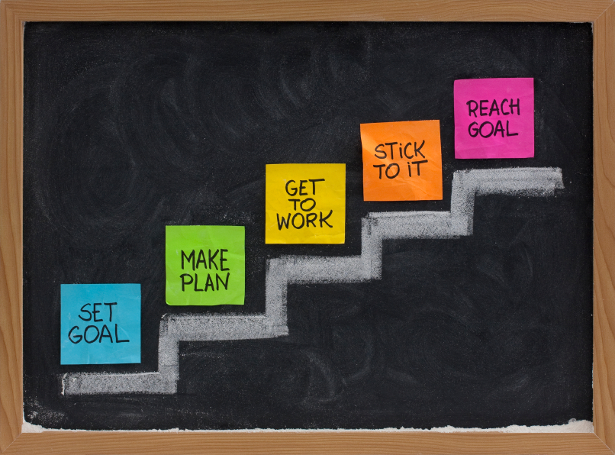
Plan
Build website using Dreamweaver
Collect songs and add to database
Uniserver and MySQL Database
Document version control
Notes:
The plan to execute was
Build website using Dreamweaver.
Team members to collect the required number of songs that are allowed to broadcast online and not breaching any copyright.
Use Uniserver to start up with our project for streaming and database purposes.
Since coding is done by more than one in the group to maintain the various versions of it
We decided to use Git repository and access it using the SourceTree app which was very convenient for us to manage various files.
Now I invite Joshua to explain the next stages of our project

Slide 6

Project Progress
Design webpages banner logo
Built a webpage template
Learn to use GitHub and SourceTree

Slide 7

Roadblocks
Issues with music streaming
song request
Team members

Slide 8


Outcome
Media player and Icecast
Working music stream
External music stream
Hosting from byethost.com

Slide 9
Demo

Slide 10

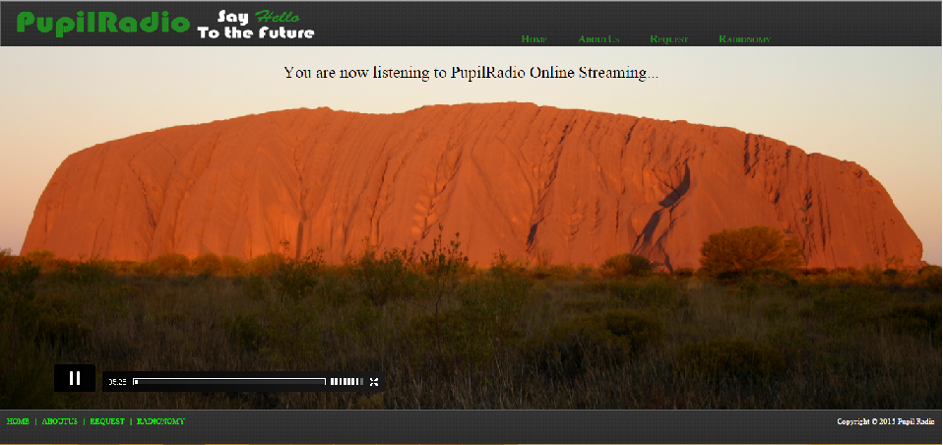
Music Streaming

Slide 11
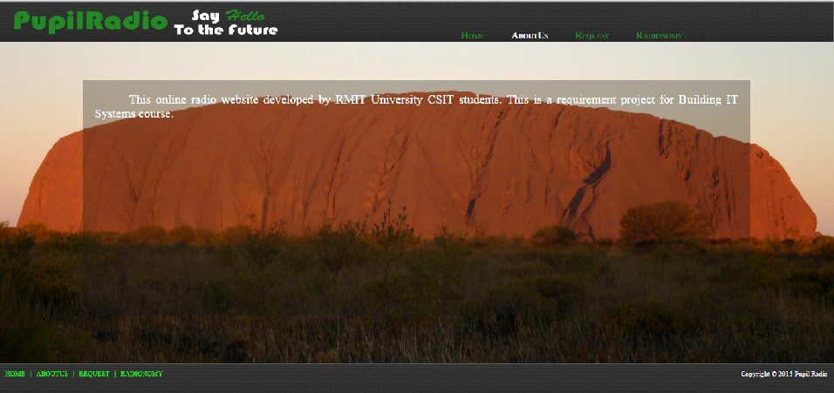
About Us Page

Slide 12
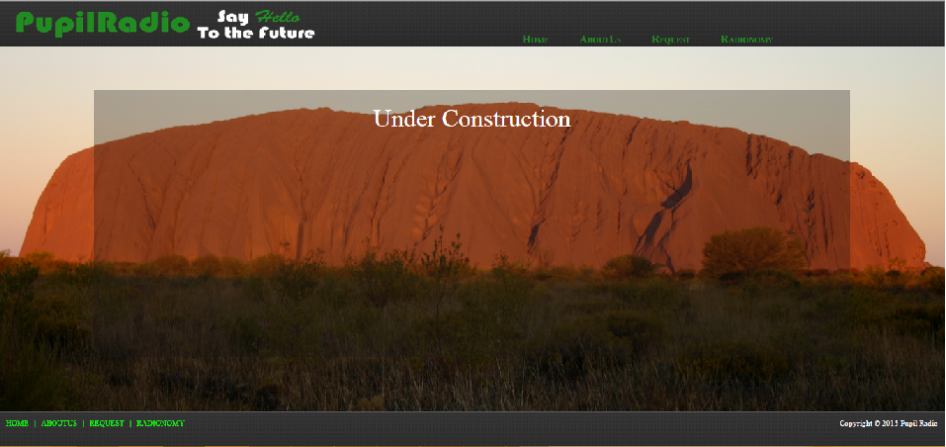
Request Page

Slide 13
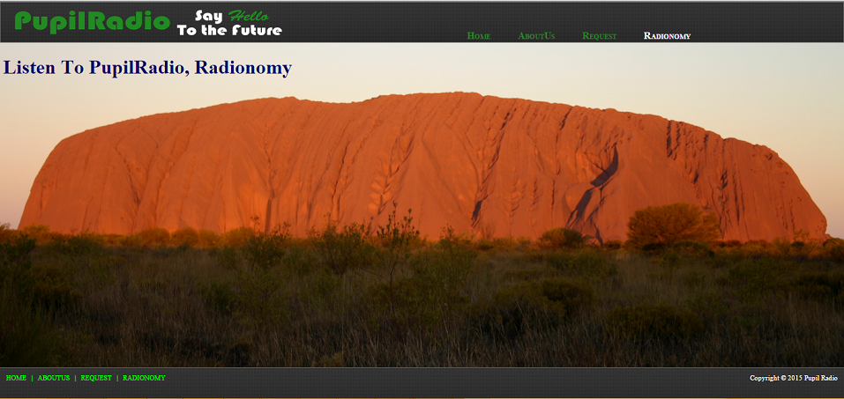
External Music Stream

Slide 14
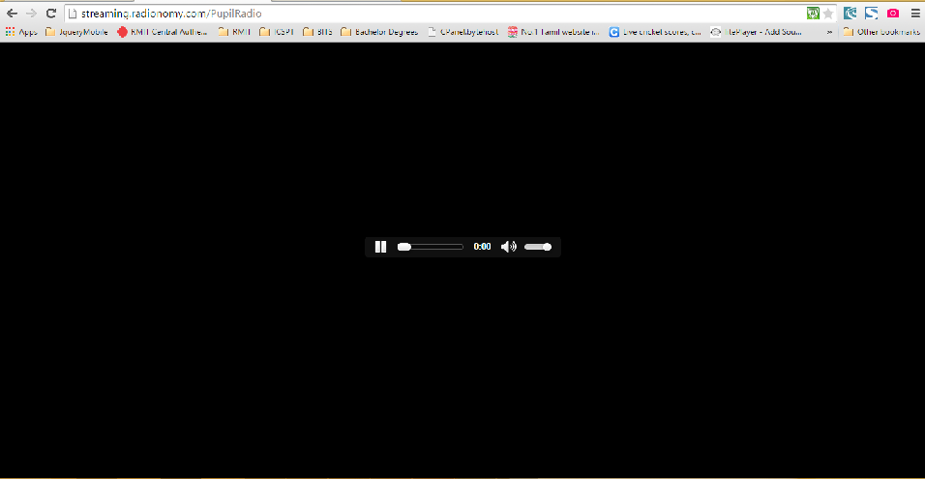
Radionomy Stream

